Slide 1

Chapter 2
Digital Image Fundamentals
Those who wish to succeed must ask the right preliminary questions.
Aristotle

Slide 2
Contents
This lecture will cover:
  The human visual system
  Light and the electromagnetic spectrum
  Image representation
  Image sensing and acquisition
  Sampling, quantisation and resolution
  Some basic relationships between pixels

Slide 3
2.1 Elements of Visual Perception
  2.1.1 Structure of the human eye
Three membranes(膜):
  cornea and sclera:眼角膜和巩膜
  choroid：脉络膜
  retina：视网膜

Slide 4
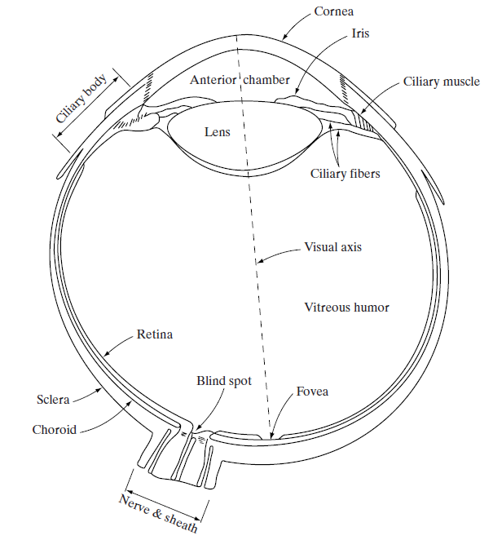
2.1 Elements of Visual Perception
Three membranes(膜):
cornea and sclera:眼角膜和巩膜
choroid：脉络膜
retina：视网膜
1. cornea: a tough, transparent tissue that covers the anterior surface of the eye. Continuous with the cornea, the sclera is an opaque membrane that encloses the remainder of the optic globe.
2. choroid: contains all of the blood vessels that serve as nutrition to the eye. divided into the ciliary body (睫状的) and the iris diaphragm (虹膜) Centre opening of iris: pupil(瞳孔)
3. Lens(晶状体): fibrous cells, is suspended by fibers of ciliary body. 60-70%water, 6%fat,most protein. Yellow pigmentation, cataracts(白内障)
Notes:
1.The cornea： is a tough, transparent tissue that covers the anterior surface of the eye. Continuous with the cornea, the sclera is an opaque membrane that encloses the remainder of the optic globe.
2.The choroid： contains all of the blood vessels that serve as nutrition to the eye
the choroid is divided into the ciliary body and the iris diaphragm
Centre opening of iris: pupil:2-8mm
3. lens: fibrous cells, is suspended by fibers of ciliary body. 60-70%water, 6%fat,most protein. Yellow pigmentation,cataracts
4. retina: The innermost membrane of the eye, light receptor, image.
Two classes light receptors: cones(6-7million, color information) and rods(75-150 million, no color, dim-light vision)
Rods for general vision cones for details, Women have extra cones which means they can see more colours
5.Fovea:is a circular with 1.5 mm in diameter. 1.5 mm*1.5 mm square,CCD
6.Blind spot is where the optic nerve connects
BLIND SPOT EXPERIMENT

Slide 5
2.1 Elements of Visual Perception
Three membranes:
cornea and sclera:角膜和巩膜
choroid：脉络膜
retina：视网膜
4. retina: The innermost membrane of the eye, light receptor, image. Two classes light receptors: cones(锥状体) (6-7million, color information) and rods (杆状体) (75-150 million, no color, dim-light vision) Rods for general vision cones for details, Women have extra cones which means they can see more colours.
5. Fovea(中央凹):is a circular with 1.5 mm in diameter. 1.5 mm*1.5 mm square, CCD
Notes:
1.The cornea： is a tough, transparent tissue that covers the anterior surface of the eye. Continuous with the cornea, the sclera is an opaque membrane that encloses the remainder of the optic globe.
2.The choroid： contains all of the blood vessels that serve as nutrition to the eye
the choroid is divided into the ciliary body and the iris diaphragm
Centre opening of iris: pupil:2-8mm
3. lens: fibrous cells, is suspended by fibers of ciliary body. 60-70%water, 6%fat,most protein. Yellow pigmentation,cataracts
4. retina: The innermost membrane of the eye, light receptor, image.
Two classes light receptors: cones(6-7million, color information) and rods(75-150 million, no color, dim-light vision)
Rods for general vision cones for details, Women have extra cones which means they can see more colours
5.Fovea:is a circular with 1.5 mm in diameter. 1.5 mm*1.5 mm square,CCD
6.Blind spot is where the optic nerve connects
BLIND SPOT EXPERIMENT

Slide 6
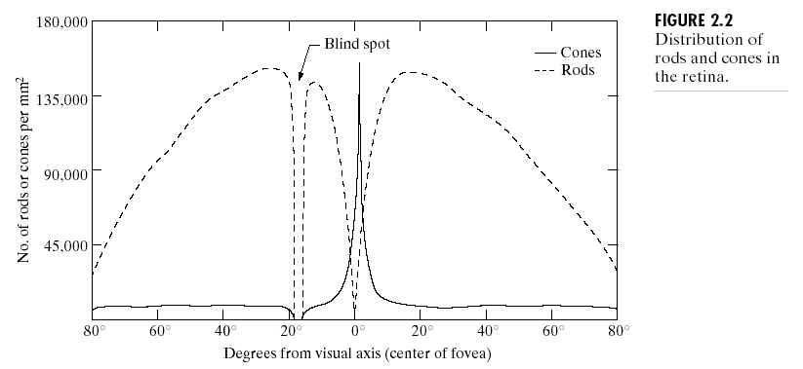
2.1 Elements of Visual Perception
Figure 2.2 shows the density of rods and cones for a cross section of the right eye passing through the region of emergence of the optic nerve from the eye.
The absence of receptors in this area results in the so-called blind spot
Notes:
Note also that rods increase in density from the center
out to approximately 20° off axis and then decrease in density out to the extreme
periphery of the retina.

Slide 7

Blind-Spot Experiment
2.1 Elements of Visual Perception
Draw an image similar to that below on a piece of paper (the dot and cross are about 6 inches, about 15cm apart)
Close your right eye and focus on the cross with your left eye
Hold the image about 20 inches away from your face and move it slowly towards you
The dot should disappear!

Slide 8
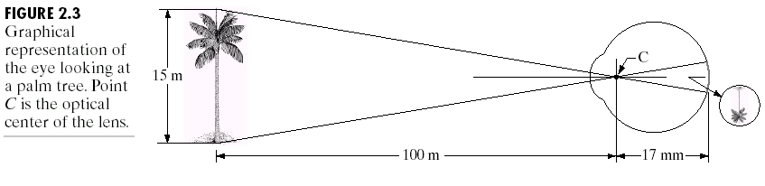
2.1.2 Image Formation in the Eye
2.1 Elements of Visual Perception
The principal difference between the lens of the eye and an ordinary optical lens is that the former is flexible
Muscles within the eye can be used to change the shape of the lens allowing us focus on objects that are near or far away
An image is focused onto the retina causing rods and cones to become excited which ultimately send signals to the brain
In Fig. 2.3, for example, the observer is looking at a tree 15 m high at a distance of 100 m. If h is the height in mm of that object in the retinal image, the geometry of Fig. 2.3 yields 15/100=h/17 or h=2.55mm,the retinal image is reflected primarily in the area of the fovea.
Notes:
Muscles within the eye can be used to change the shape of the lens allowing us focus on objects that are near or far away
An image is focused onto the retina causing rods and cones to become excited which ultimately send signals to the brain

Slide 9
2.1.3 Brightness adaptation and discrimination
2.1 Elements of Visual Perception
The human visual system can perceive approximately 1010 different light intensity levels
However, at any one time we can only discriminate between a much smaller number – brightness adaptation
Experimental evidence indicates that subjective brightness (intensity as perceived by the Human visual system) is a logarithmic function of the light intensity incident on the eye.

Slide 10
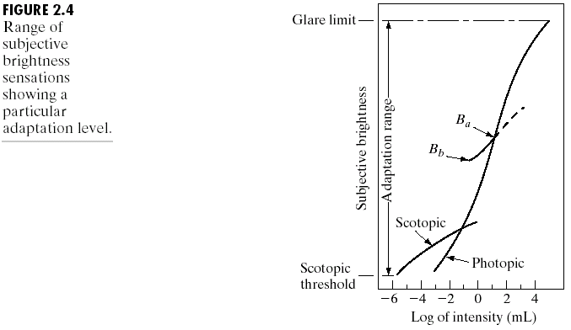
2.1 Elements of Visual Perception
to brightness B_{a} in Fig. 2.4.The short intersecting curve represents the range of subjective brightness that the eye can perceive when adapted to this level. This range is rather restricted, having a level B_{b} at and below which all stimuli are perceived as indistinguishable blacks.
The upper (dashed) portion of the curve is not actually restricted but, if extended
too far, loses its meaning because much higher intensities would simply raise the adaptation level higher than B_{a} .

Slide 11
2.1 Elements of Visual Perception
Some phenomena clearly demonstrate that perceived brightness is not a simple function of intensity.
  Mach bands
These seemingly scalloped bands are called Mach bands after Ernst Mach, who first described the phenomenon in 1865.

Slide 12
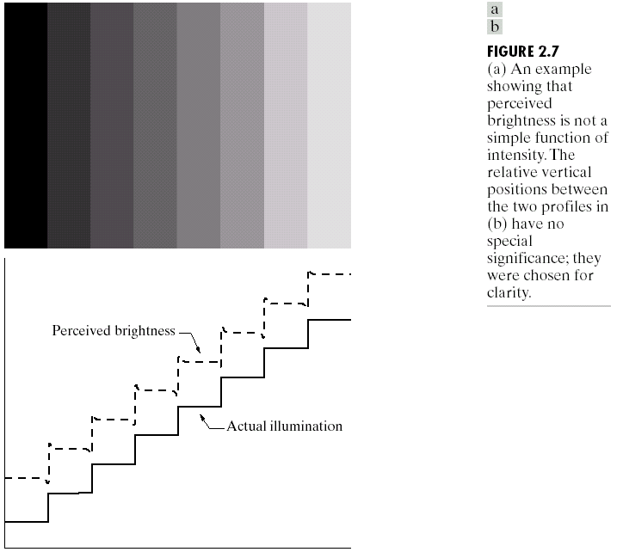
2.1 Elements of Visual Perception
Figure 2.7(a) shows a striking example of this phenomenon. Although the intensity of the stripes is constant, we actually perceive a brightness pattern that is strongly scalloped, especially near the boundaries [(b)].

Slide 13
2.1 Elements of Visual Perception
  Simultaneous contrast
The second phenomenon, called simultaneous contrast, is related to the fact that a region’s perceived brightness does not simply depend on its intensity, as Fig. 2.8 demonstrates.

Slide 14
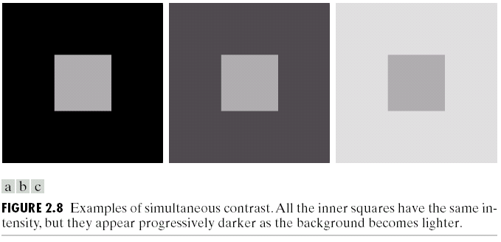
2.1 Elements of Visual Perception
Eg: A piece of paper that seems white when lying on a desk, but can appear totally black when used to shield the eyes while looking directly at a bright sky.

Slide 15
2.1 Elements of Visual Perception
  Optical illusion
Other examples of human perception phenomena are optical illusions, in which the eye fills in non-existing information or wrongly perceives geometrical properties of objects.

Slide 16
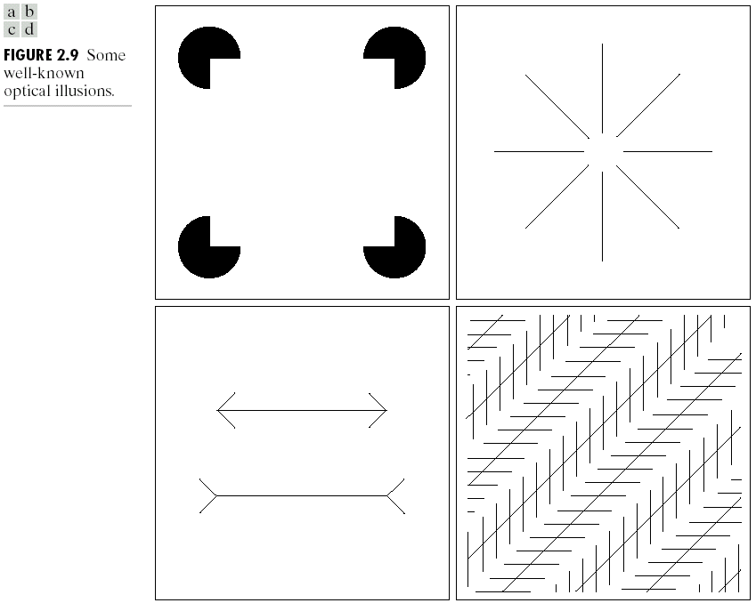
2.1 Elements of Visual Perception

Slide 17
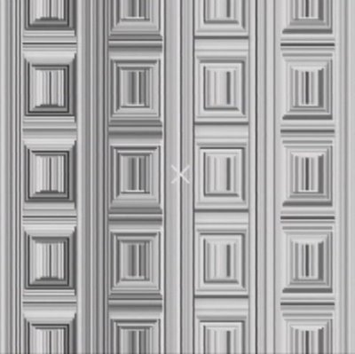
2.1 Elements of Visual Perception
  Optical illusion – more examples
Stare at the cross in the middle of the image and think circles

Slide 18
2.1 Elements of Visual Perception
  Optical illusion – more examples
For more great illusion examples :
http://web.mit.edu/persci/gaz/
Notes:
Mach bands were named after Ernst Mach who described the phenomenon in 1865

Slide 19
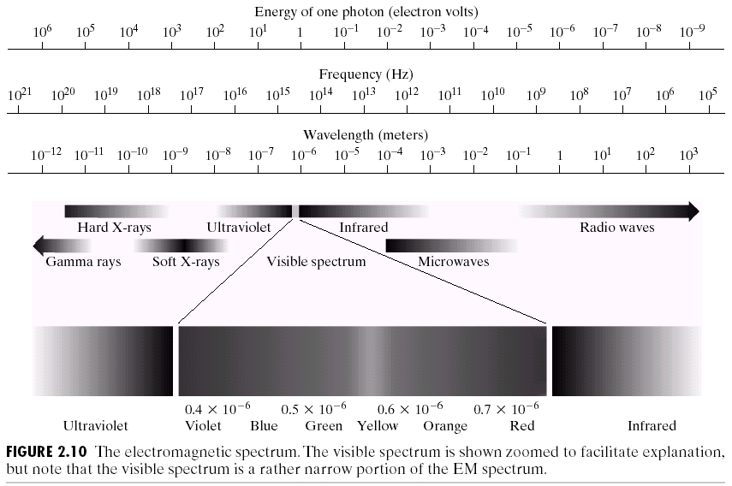
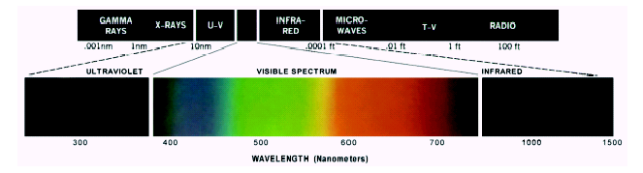
2.2 Light and Electromagnetic Spectrum

Slide 20

Reflected Light
2.2 Light and Electromagnetic Spectrum
The colours that we perceive are determined by the nature of the light reflected from an object
For example, if white
light is shone onto a green object
most wavelengths are absorbed,
while green light is reflected from
the object
White Light
Colours Absorbed
Green Light

Slide 21
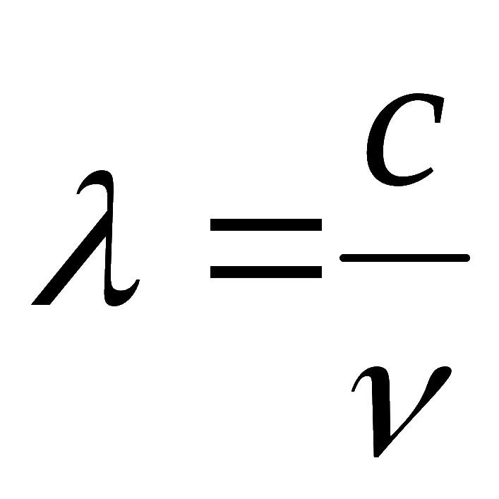
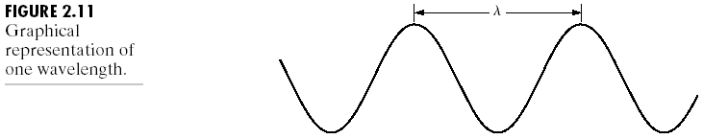
2.2 Light and Electromagnetic Spectrum
The electromagnetic spectrum can be expressed in terms of wavelength, frequency, or energy.
Wavelength (λ) and frequency (ν) are related by the expression :
The energy of the various components of the electromagnetic spectrum is given by the expression:
where c is the speed of light and h is Planck’s constant.

Slide 22

2.3 Image sensing and acquisition
Images are typically generated by illuminating a scene and absorbing the energy reflected by the objects in that scene

Slide 23
Image sensing
2.3 Image sensing and acquisition
Image sensing: to transform illumination energy into digital images.
The idea is simple: Incoming energy is transformed into a voltage by the combination of input electrical power and sensor material that is responsive to the particular type of energy being detected.
The output voltage waveform is the response of the sensor(s), and a digital quantity is obtained from each sensor by digitizing its response.

Slide 24
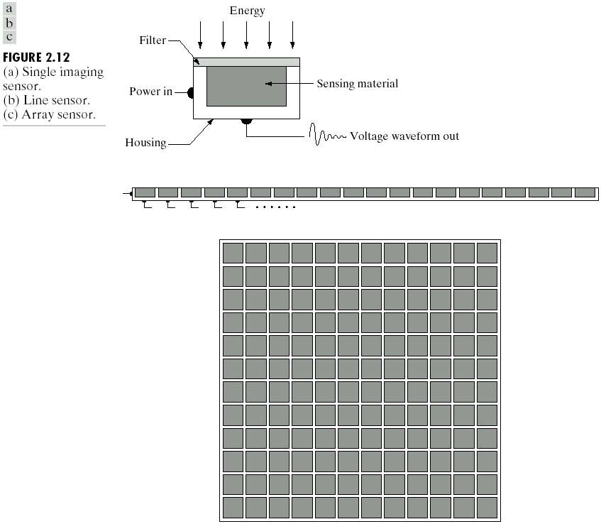
2.3 Image sensing and acquisition
Figure 2.12 shows the three principal sensor arrangements used to transform illumination energy into digital images.

Slide 25
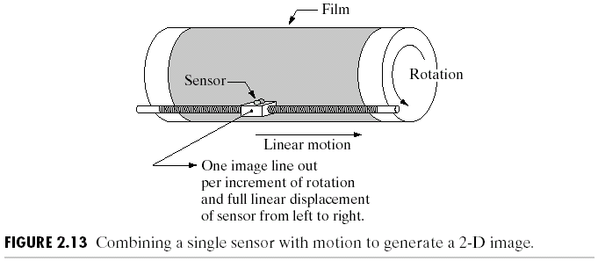
2.3.1 Image Acquisition Using a single Sensor
2.3 Image sensing and acquisition
Single sensor
Inexpensive but slow
Rotation

Slide 26
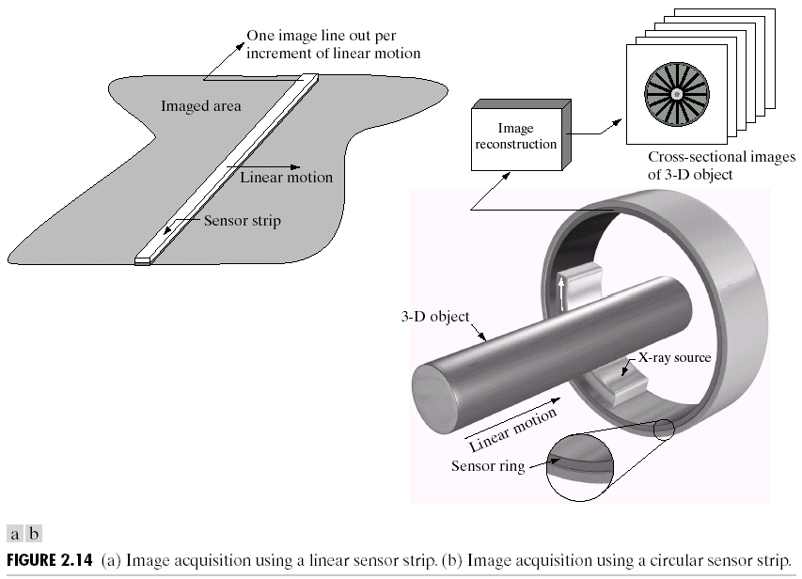
2.3.2 Image Acquisition Using Sensor Strips
2.3 Image sensing and acquisition
≥ 4000 sensors
Flat bed
Linear motion
Sensor ring, 3D
CAT, MRI

Slide 27
2.3.3 Image Acquisition Using Sensor Arrays
2.3 Image sensing and acquisition
≥4000*4000 sensors
no motion
typical example: CCD (Charge Coupled Device)

Slide 28
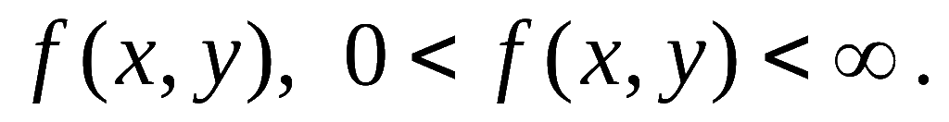

2.3.4 A simple image formation model
2.3 Image sensing and acquisition
Images are denoted by two-dimensional functions of the form
which may be characterized by two components:
  illumination： the amount of source illumination incident on the scene being viewed；i(x, y）
  reflectance： amount of illumination reflected by the objects in the scene, r(x, y）
That is
where

Slide 29
2.3 Image sensing and acquisition
2.3.4 A simple image formation model
typical ranges of i(x, y) for visible light：
> 90,000 lm/m2 on a clear day of sun
the surface of the Earth:
<10,000 lm/m2 on a cloudy day.
0.1 lm/m2 on a clear evening/a full moon
a commercial office: 1000 lm/m2.
typical values of r(x, y):
0.01 for black velvet (天鹅绒),
0.65 for stainless steel,
0.80 for flat-white wall paint,
0.90 for silver-plated metal,
0.93 for snow.

Slide 30


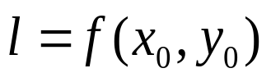





2.3 Image sensing and acquisition
We call the intensity of a monochrome image at any coordinates the gray level ( ) of the image at that point. That is
It is evident that lies in the range
The interval is called the gray scale, which in practice is the interval , where
is considered black and is considered white on the gray scale. we may expect Lmin ≈10 and Lmax ≈ 1000 to be typical limits for indoor values

Slide 31
2.4 Image sampling and quantization
our objective in all: to generate digital images from sensed data.
To create a digital image, we need to convert the continuous sensed data into digital form.
This involves two processes:
  sampling：Digitizing the coordinate values
  quantization：Digitizing the amplitude values

Slide 32
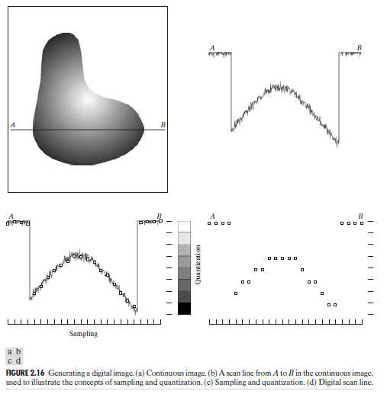
2.4 Image sampling and quantization

Slide 33

2.4 Image sampling and quantization
Remember that a digital image is always only an approximation of a real world scene
Clearly, the quality of a digital image is determined to a large degree by the number of samples and discrete gray levels used in sampling and quantization. However, image content is an important consideration.

Slide 34
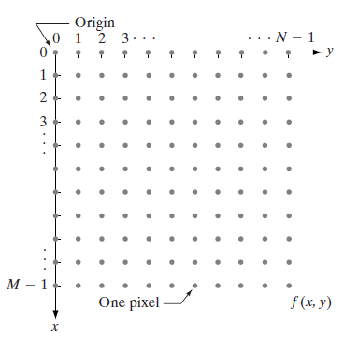
2.4.2 Representing digital images matrix
2.4 Image sampling and quantization
f(x, y) : with M rows and N columns
coordinates at the origin:
(x, y)=(0, 0).
It is important to keep in mind that the notation (0, 1) is used to signify the second sample along the first row. It does not mean that these are the actual values of physical coordinates when the image was sampled

Slide 35
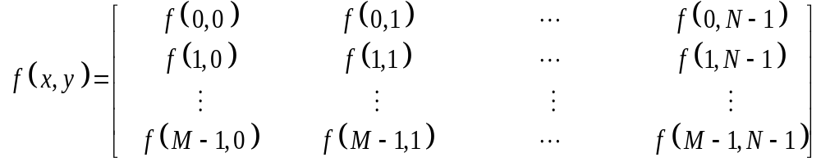
2.4 Image sampling and quantization
The result of sampling and quantization is a matrix of real numbers.
Assume that an image f(x, y) is sampled so that the resulting digital image has M rows and N columns.
The right side of this equation is by definition a digital image.
Each element of this matrix array is called an image element, picture element, pixel, or pel.

Slide 36
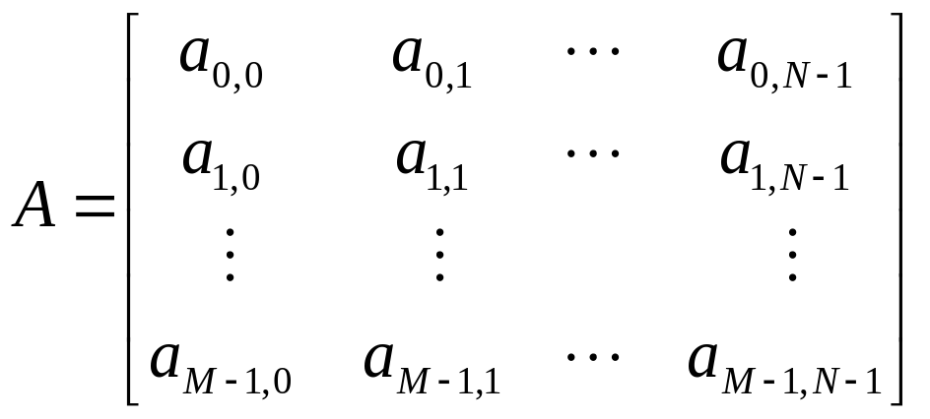
2.4 Image sampling and quantization
In some discussions, it is advantageous to use a more traditional matrix notation to denote a digital image and its elements:
Clearly, a_{ij}=f(x=i, y=j)=f(i, j), so they are identical matrices.

Slide 37
2.4 Image sampling and quantization
There are no requirements on M and N, other than that
they have to be positive integers. However, due to
processing, storage, and sampling hardware considerations,
the number of gray levels typically is an integer power of 2:
L = 2^{k}
Gray level interval [0, L-1].
dynamic range of an image: the range of values spanned by the gray scale.
  high dynamic range: high contrast
  low dynamic range: dull, washed out gray look

Slide 38
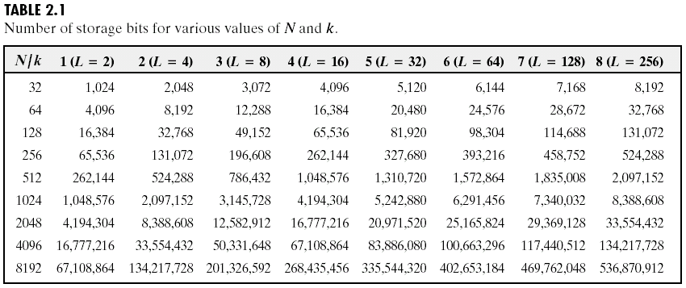
2.4 Image sampling and quantization
The number, b, of bits required to store a digitized image is
b=M ×N ×k.
When M=N, this equation becomes:
b = N²k
2^{k} gray levels: “k-bit image.” eg: 256 possible values: 8-bit image.

Slide 39
2.4.3 Spatial and gray-level resolution
2.4 Image sampling and quantization
Sampling is the principal factor determining the spatial resolution of an image. Spatial resolution is the smallest discernible (可辨别的) detail in an image.
Gray-level resolution similarly refers to the smallest discernible change in gray level. the number of gray levels is usually an integer power of 2, eg.: 8 bits, 16 bits
it is not uncommon to refer to an L-level digital image of size M*N as having a spatial resolution of M*N pixels and a gray-level resolution of L levels. We will use this terminology from time to time in subsequent discussions

Slide 40
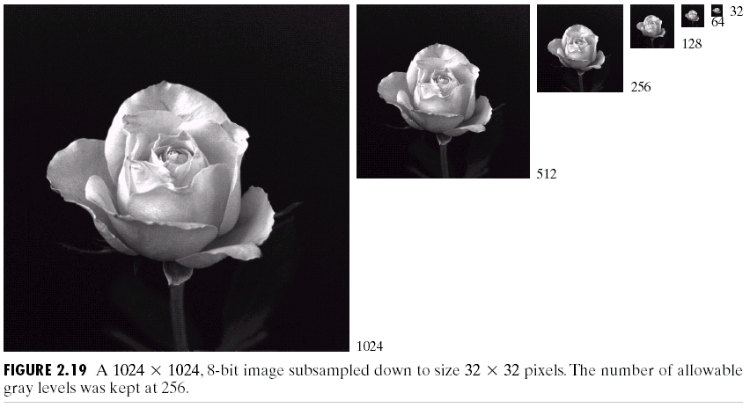
2.4 Image sampling and quantization
Typical effects of varying spatial resolution:
the 512*512 image was obtained by deleting every other row and column from the 1024*1024 image. The 256*256 image was generated by deleting every other row and column in the 512*512 image, and so on.
The number of allowed gray levels was kept at 256.
Notes:
These images show the dimensional proportions between various sampling densities, but their size differences make it difficult to see the effects resulting from a reduction in the number of samples.

Slide 41
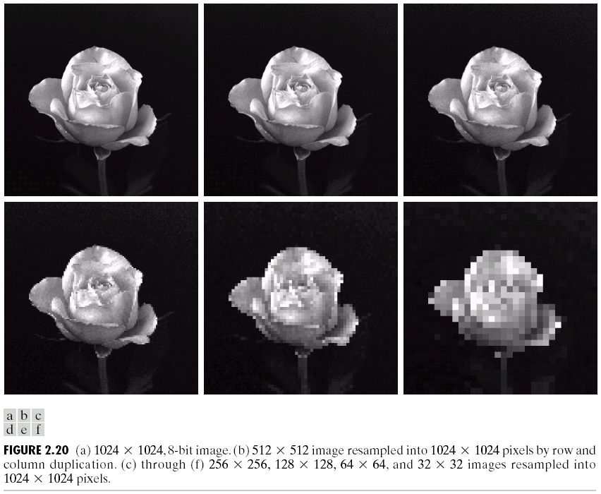
2.4 Image sampling and quantization
size differences make it difficult to see the effects
bring all the subsampled images up to size 1024*1024 by pixel replication
Checker boards
Notes:
The simplest way to compare these effects is to bring all the subsampled images up to size 1024*1024 by row and
column pixel replication

Slide 42


2.4 Image sampling and quantization
Typical effects of varying Gray-level resolution: In this example, we keep the number of samples constant (452*374) and reduce the number of gray levels from 256 to 2, in integer powers of 2. --- false contouring
256 grey levels (8 bits per pixel)
128 grey levels (7 bpp)
64 grey levels (6 bpp)
32 grey levels (5 bpp)
16 grey levels (4 bpp)
8 grey levels (3 bpp)
4 grey levels (2 bpp)
2 grey levels (1 bpp)

Slide 43
Resolution: How Much Is Enough?
2.4 Image sampling and quantization
The big question with resolution is always how much is enough?
  This all depends on what is in the image and what you would like to do with it
  Key questions include
    Does the image look aesthetically (审美地) pleasing?
    Can you see what you need to see within the image?

Slide 44

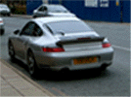
Resolution: How Much Is Enough? (cont…)
2.4 Image sampling and quantization
The picture on the right is fine for counting the number of cars, but not for reading the number plate

Slide 45
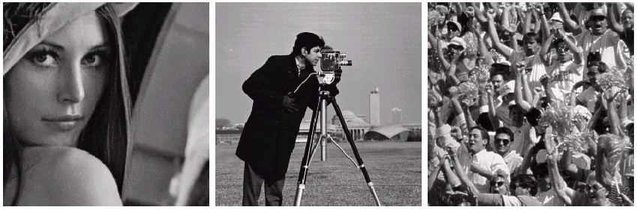
Intensity Level Resolution
2.4 Image sampling and quantization
Previous examples: varying N and k independently
Nk-plane: relationships between these two parameters
Low Detail
Medium Detail
High Detail

Slide 46
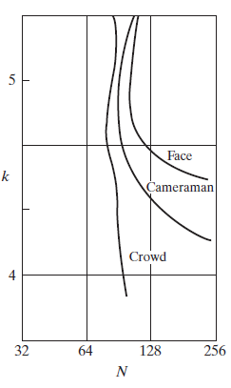
Isopreference(优等先) curves
2.4 Image sampling and quantization
Points lying on an isopreference curve correspond to images of equal subjective quality
shift right and upward, with similar shapes
Crowd: almost vertical: fixed N, independent of k
Face & cameraman: N increased, but k decreased: decrease in k, increase the apparent contrast, visual effect that humans often perceive as improved quality in an image.

Slide 47
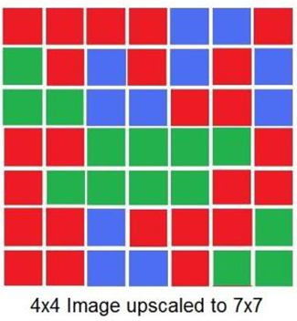
2.4.5 Zooming and shrinking
2.4 Image sampling and quantization
zooming : oversampling
shrinking : undersampling
Zooming requires two steps:
  creation of new pixel locations
  assignment of gray levels to those new locations
nearest neighbor interpolation：

Slide 48
2.4 Image sampling and quantization
2.4.5 Zooming and shrinking
Pixel replication: a special case of nearest neighbor interpolation. Eg: to double the size, duplicate each column and each row horizontally vertically.
triple, quadruple, and so on. Duplicate required number of times to achieve the desired size.
Notes:
Pixel replication is applicable
when we want to increase the size of an image an integer number of times.

Slide 49
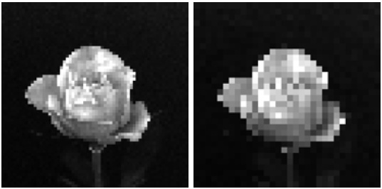
2.4 Image sampling and quantization
checkerboard effect: Although nearest neighbor interpolation is fast, it has the undesirable feature that it produces a checkerboard effect that is particularly objectionable (讨厌的) at high factors of magnification. Figures 2.20(e) and (f) are good examples of this

Slide 50
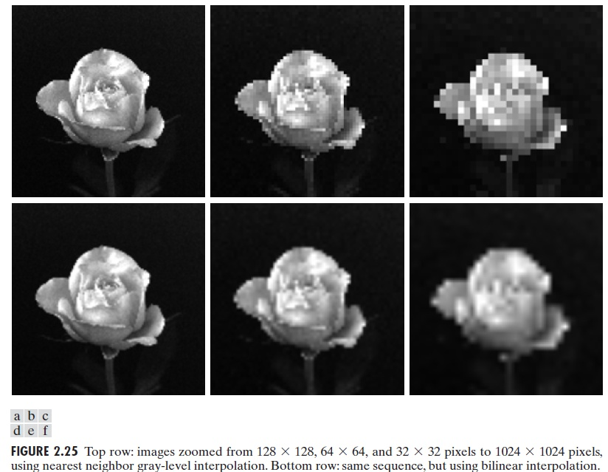
2.4 Image sampling and quantization
bilinear interpolation: using the four nearest neighbors of a point. Let (x’, y’) denote the coordinates of a point in the zoomed image, and let v(x’, y’) denote the gray level assigned to it: v(x’, y’) = ax’+ by’+ cx’y’+ d

Slide 51
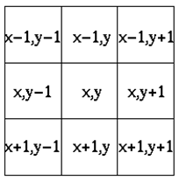

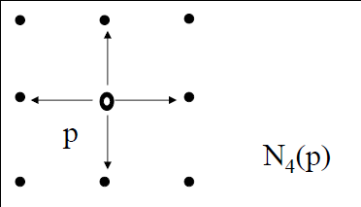

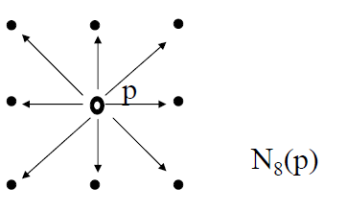

2.5 Some basic relationships between pixels
2.5.1 Neighbors of a pixel
4-neighbors：
A pixel p at coordinates (x, y) has four horizontal and vertical neighbors whose coordinates are given by
(x+1, y), (x-1, y), (x, y+1), (x, y-1)
This set of pixels, called the 4-neighbors of p, is denoted by
8-neighbors:
The four diagonal neighbors of p have coordinates:
(x+1, y+1), (x+1, y-1), (x-1, y+1), (x-1, y-1)
are denoted by （diagonal neighbors）
These points, together with the 4-neighbors, are called the 8-neighbors of p, denoted by

Slide 52
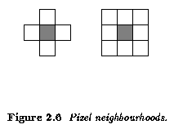

2.5 Some basic relationships between pixels
4-neighbors, 8-neighbors

Slide 53
2.5.2 Adjacency, Connectivity, Regions and Boundaries
2.5 Some basic relationships between pixels
Connectivity
• Two pixels are connected if they are neighbors and their gray levels satisfy some specified criterion of similarity.
• For example, in a binary image two pixels are connected if they are 4-neighbors and have same value (0/1).

Slide 54

2.5 Some basic relationships between pixels
Adjacency
V : set of gray levels values to define adjacency.
• 4-adjacency: Two pixels p and q with values from V are 4-adjacent if q is in the set N₄(p).
• 8-adjacency: Two pixels p and q with values from V are 8-adjacent if q is in the set N₈(p).
• m-adjacency: Two pixels p and q with values from V are
m-adjacent if,
– q is in N₄(p), or
– q is in N_{D}(p) and the set is empty
(has no pixels whose values are from V).

Slide 55
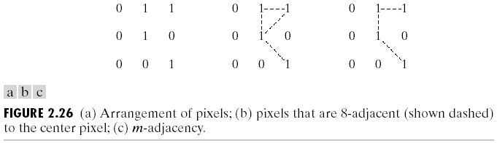
2.5 Some basic relationships between pixels
m-adjacency: a modification of 8-adjacency.
to eliminate the ambiguities in 8-adjacency
Fig. 2.26(a) for V={1}.The three pixels at the top of Fig. 2.26(b) show multiple (ambiguous) 8-adjacency, as indicated by the dashed lines. This ambiguity is removed by using m-adjacency, as shown in Fig. 2.26(c)
Notes:
Fig. 2.26(a) for V={1}.The three pixels at the top of Fig. 2.26(b) show multiple (ambiguous) 8-adjacency, as indicated by
the dashed lines.This ambiguity is removed by using m-adjacency, as shown in Fig. 2.26(c)

Slide 56
2.5 Some basic relationships between pixels
Path
A (digital ) path (or curve) from pixel p with coordinates (x, y) to pixel q with coordinates (s, t) is a sequence of distinct pixels with coordinates:
(x₀ , y₀), (x₁ , y₁), ... , (x_{n} , y_{n})
where (x₀, y₀)=(x, y) and (x_{n}, y_{n})=(s, t); (x_{i}, y_{i}) is adjacent to
(x_{i-1}, y_{i-1}), 1≤ i ≤ n
Here n is the length of the path.
We can define 4-, 8-, and m-paths based on type of adjacency used.
Note the absence of ambiguity in the m-path.

Slide 57
2.5 Some basic relationships between pixels
Connected Components
• If p and q are pixels of an image subset S then p is connected to q in S if there is a path from p to q consisting entirely of pixels in S.
• For any pixel p in S, the set of pixels in S that are connected to p is called a connected component of S.
• If S has only one connected component then S is called Connected Set.
Notes:
examples

Slide 58
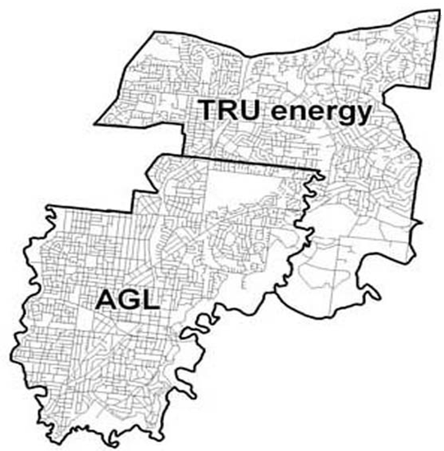
2.5 Some basic relationships between pixels
Region, Boundary and Edge
Region and Boundary:
R is a subset of pixels in an image. We call R a region of the image if R is a connected set.
The boundary (also called border or contour) of a region R is the set of pixels in the region that have one or more neighbors that are not in R.
If R happens to be an entire image,
then its boundary is defined as the set
of pixels in the first and last rows
and columns of the image

Slide 59
2.5 Some basic relationships between pixels
Region, Boundary and Edge
Region and Boundary:
The boundary of a finite region forms a closed path and is thus a “global” concept.
Edges are formed from pixels with derivative values that exceed a preset threshold. Thus is a “local” concept that is based on a measure of gray-level discontinuity at a point.
possible to link edge points into edge segments, and then to boundaries, but not always.
helpful to think of edges as intensity discontinuities and boundaries as closed paths

Slide 60
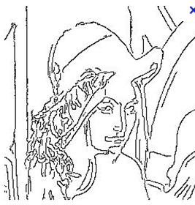
Boundary and edge:
2.5 Some basic relationships between pixels
Boundary of a region
Canny operator—edge detection

Slide 61
2.5.3 Distance Measures
2.5 Some basic relationships between pixels
For pixels p, q, and z, with coordinates (x, y), (s, t), and (v, w), respectively, D is a distance function or metric if
D(p, q) ≧0 (D(p, q)=0 if p=q)： Non-negativity
(b) D(p, q) = D(q, p)： Symmetry
(c) D(p, z) ≦ D(p, q) + D(q, z)：Triangle inequality

Slide 62
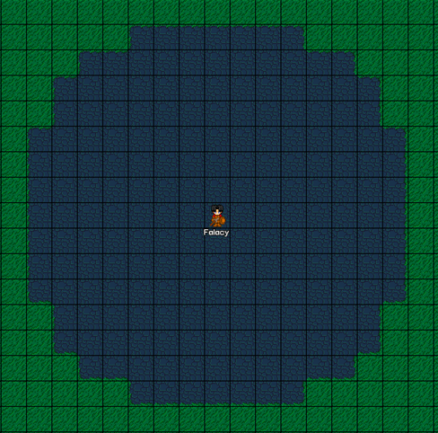
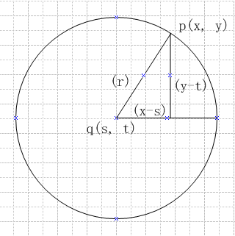
2.5 Some basic relationships between pixels
Euclidean distance
the pixels having a distance less than or equal to some
value r from (x, y) are the points contained in a disk of radius r centered at (x, y)

Slide 63
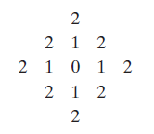
2.5 Some basic relationships between pixels
D₄ distance (city-block distance)
the pixels having a D₄ distance from (x, y) less than or equal to some value r form a diamond centered at (x, y).
Eg：D₄ distance ≤ 2 from (x, y) (the center point 0)：
The pixels with D₄ =1 are the 4-neighbors of (x, y).

Slide 64
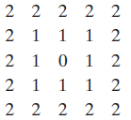
2.5 Some basic relationships between pixels
D8 distance (chessboard distance)
the pixels withD₈ distance from (x, y) less than or equal to some value r form a square centered at (x, y).
Eg：D₈ distance ≤ 2 from (x, y) (the center point 0)：
The pixels with D₈ =1 are the 8-neighbors of (x, y).

Slide 65
Dm distance
2.5 Some basic relationships between pixels
Note: the D₄ and D₈ distances are independent of any paths(points) since only coordinates involved.
However, D_{m} distance: the shortest m-path between the points. Depend on the points(values)
Eg: assume that p, p₂ , and
p₄ have value 1, V={1}
  p₁=p₃=0: D_{m}(p, p₄) = 2(pp₂p₄)
  p₁=1, p₃=0: D_{m}(p, p₄) = 3 (pp₁p₂p₄)
  p₁=0,p₃=1: D_{m}(p, p₄) = 3 (pp₂p₃p₄)
  p₁=p₃=1: D_{m}(p, p₄) = 4 (pp₁p₂p₃p₄)
0 | 0 | 0 | 0 | 0
0 | 0 | p₃ | p₄(1) | 0
0 | p₁ | p₂(1) | 0 | 0
0 | p(1) | 0 | 0 | 0
0 | 0 | 0 | 0 | 0

Slide 66
2.5.4 Image operation on a pixel basis
2.5 Some basic relationships between pixels
Arithmetic and logic operations are similarly defined between corresponding pixels in the images involved.
“dividing one image by another,”: specifically the division is carried out between corresponding pixels in the two images.

Slide 67

2.6 Linear and Nonlinear Operations
Let H be an operator. H is said to be a linear operator if, for any two images f and g and any two scalars a and b,
An operator that fails the above test is by definition nonlinear.
Eg:
The sum of K images is a linear operator.
The absolute value of the difference of two images is not.

Slide 68
Summary
We have looked at:
  Human visual system
  Light and the electromagnetic spectrum
  Image sensing and acquisition
  Sampling, quantisation and resolution
  Basic relationship between pixels
Next time we start to look at techniques for image enhancement

